Slide 1
Benchmarking Solana DLT
Dependable Distributed Systems 2023/2024
Francesco Bianchi 1942637
Valerio Massimo Camaiani 1935012

Slide 2
Table of contents
Introduction
Scope
and Goals
Testing Environment
Results Analysis
01.
03.
02.
04.

Slide 3
01.
Introduction
The solana DLT

Slide 4
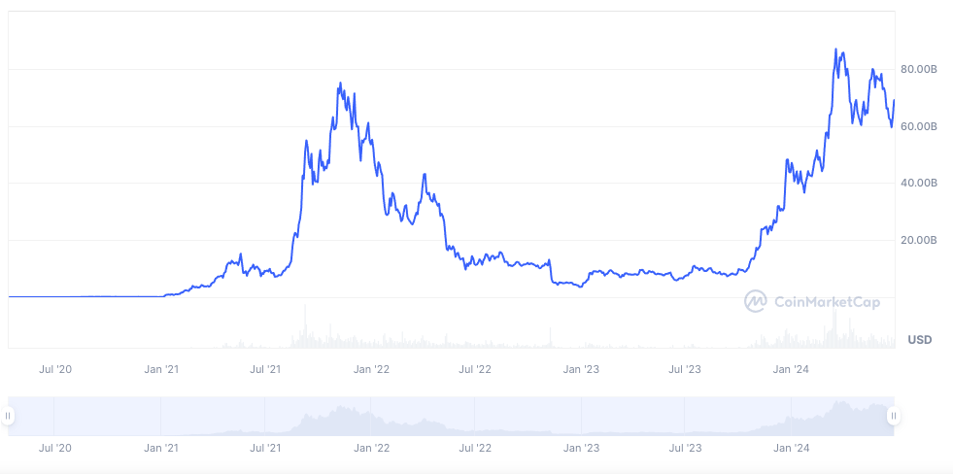
Solana
Solana Market Cap

Slide 5
Solana
Scalability and speed
Proof of History
Gas-less environment
Priority fees
Rust

Slide 6

Blockchain Environment
Programs
Raw Transactions
Custom program
Client Environment
Testing Environment

Slide 7



Blockchain Framework
Solana CLI
Anchor
Solana SDK
Providing the local validator node
A Rust framework to simplify the development and testing of solana smart contracts
Exposes tools to interact with the network

Slide 8
Programs
Raw Transactions
Basic Functionality
Efficiency Testing
Custom
Program
Program overhead
Simulated Load
More scenarios
Test CUs limit

Slide 9
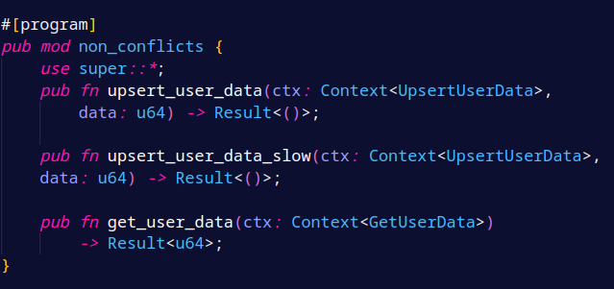
Custom program

Slide 10
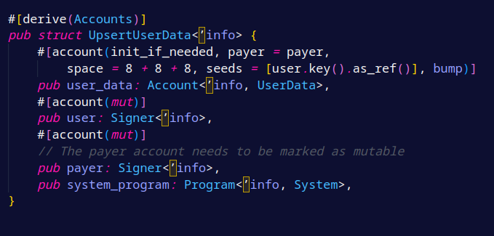
Payer Contract

Slide 11
Client Side Benchmarking
Interaction:
@coral-xyz/anchor:
high-level abstraction but limited
@solana/web3.js:
low level sdk for advanced features
borsh
Rust standard serialization library
Black Box Approach : Our benchmarking approach treats the blockchain as a black box, focusing on client-side metrics.
Commitment levels:
Processed: Received and executed on the node
Confirmed: Included in a block
Finalized: Appended to the blockchain.

Slide 12

Transaction Types
Read vs. Write Operations
Compute Intensity
Scheduler Performance
Conflict Scenarios
Scope And Goals

Slide 13
Transaction Types
Raw Transactions
Smart Contract Calls
High Efficiency: Optimized for speed with direct account transfers.
Simplicity: Straightforward SOL exchanges without contract code.
Complexity: Involves executing contract code, adding layers to transactions.
Variable Performance: Potentially slower due to the complexity of operations.

Slide 14
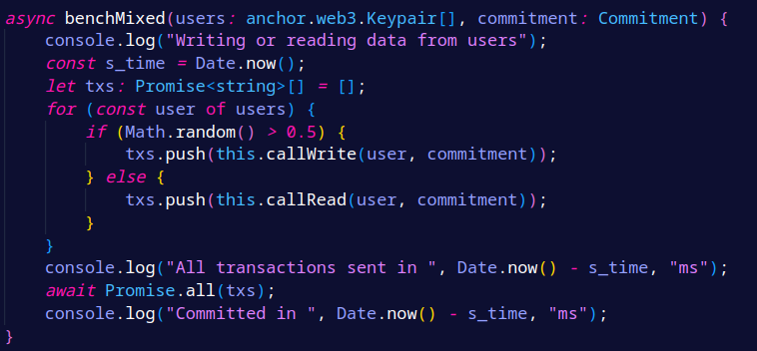
Read VS Writes

Slide 15
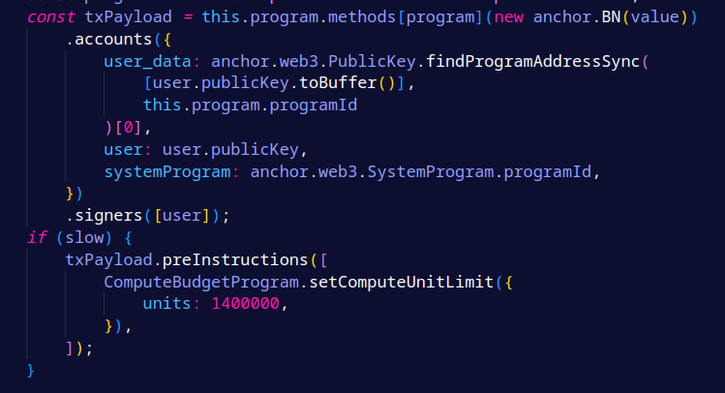
Compute Intensity
Compute Units
Low vs High

Slide 16
Schedulers
Old
New
ThreadLocalMultiIterator
CentralScheduler
A queue for each thread
A central orchestrator
Worker threads

Slide 17
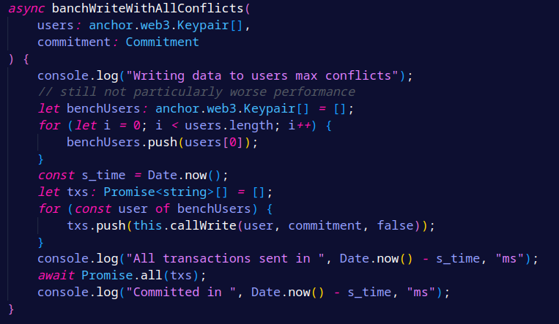
Conflicting Transactions

Slide 18
04.
Raw Transactions vs. Smart Contract Calls
Read vs. Write Operations
Low vs. High Compute Intensity
Scheduler Performance
Conflict Scenarios
Results Analysis

Slide 19
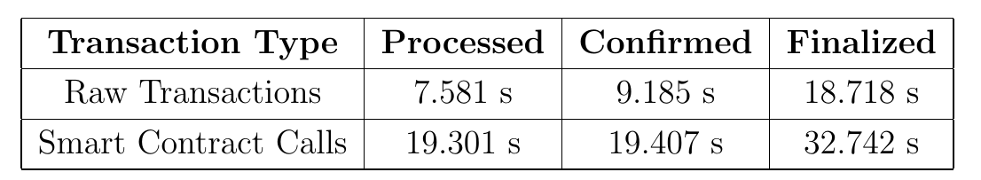
Transaction Types
Raw transactions are way faster than the program call
Processing and Confirmation times are almost the same

Slide 20
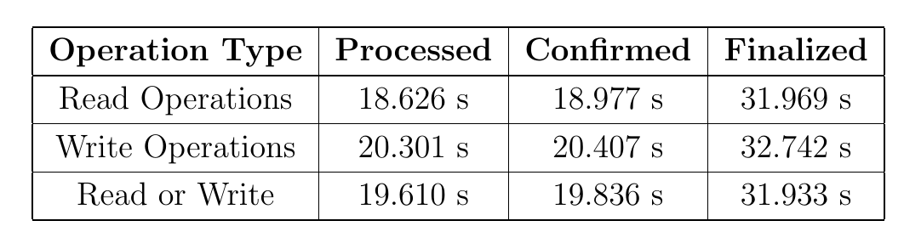
Read VS Writes
Writes are slightly slower
Solana locking is very optimized

Slide 21
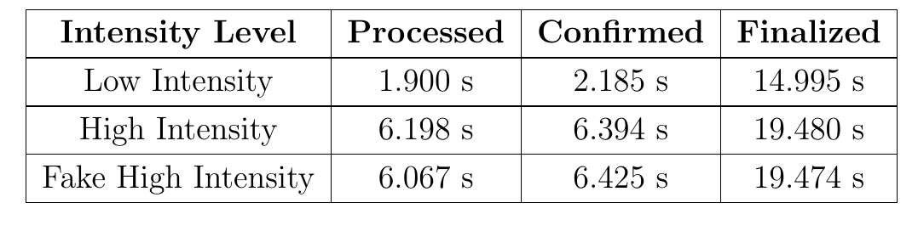
Compute Intensity
Increased cost
Minimal Finalization impact
High CU limit impact

Slide 22
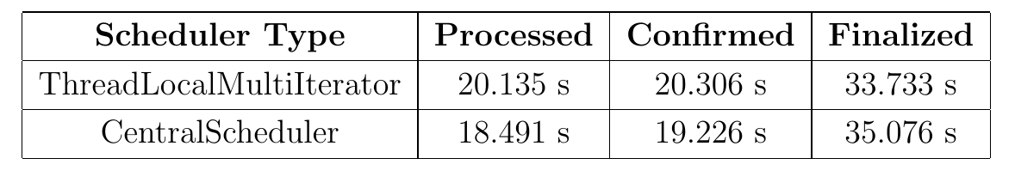
Schedulers
Minimal difference
Central scheduler has higher variance

Slide 23
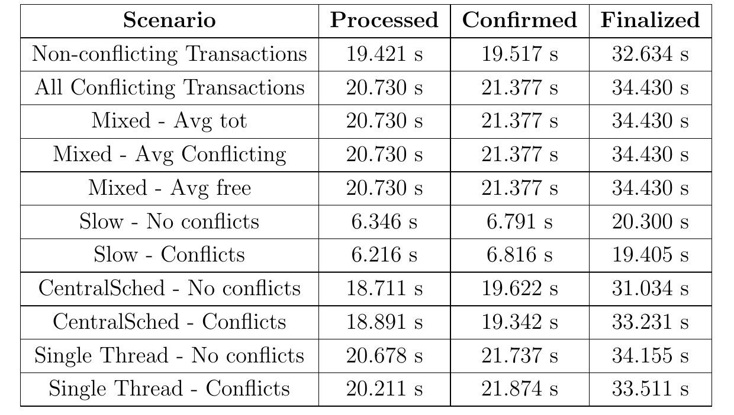
Conflicting Transactions
Optimized rescheduling
Not leveraging multiple threads

Slide 24

QUESTIONS?
Francesco Bianchi 1942637
Valerio Massimo Camaiani 1935012

